Slide 1
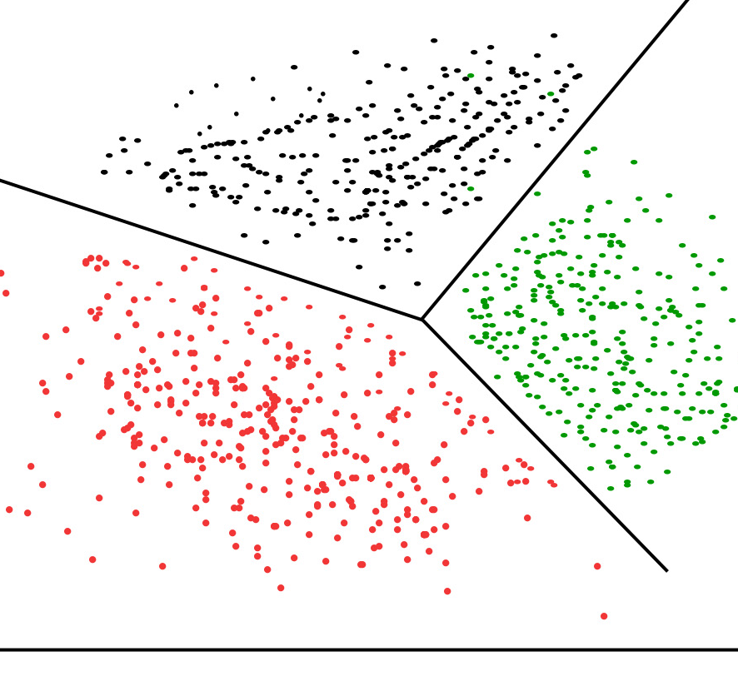
CLUSTER ANALYSIS
HIERARCHICAL & K-MEANS CLUSTERING

Slide 2
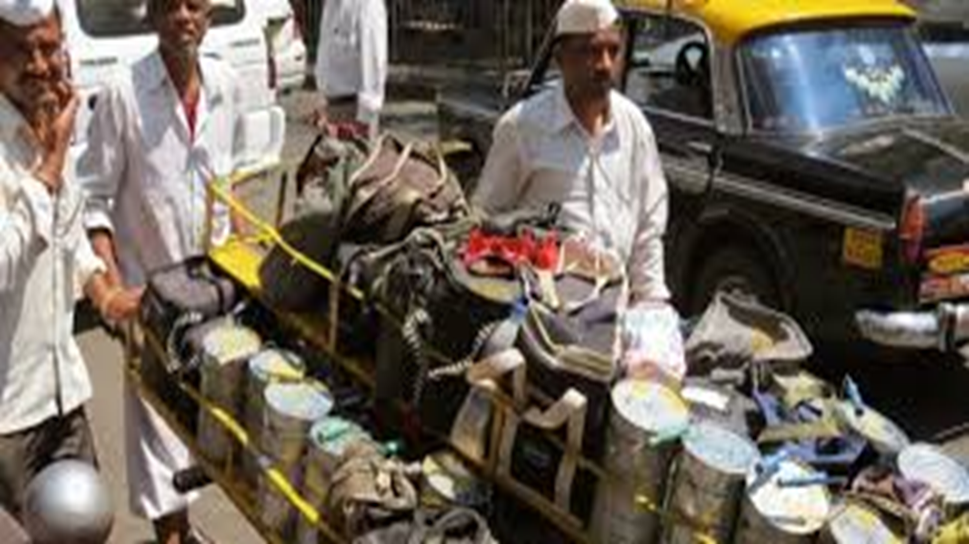
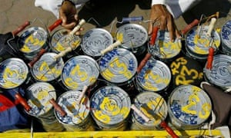

Slide 3


Slide 4
Cluster Analysis
Cluster Analysis (“data segmentation”) is an exploratory method for identifying homogeneous groups (“clusters”) of records.
Similar records should belong to the same cluster.
Dissimilar records should belong to different clusters.

Slide 5
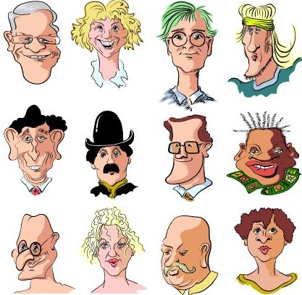
Case | Sex | Glasses | Moustache | Smile | Hat
1 | m | y | n | y | n
2 | f | n | n | y | n
3 | m | y | n | n | n
4 | m | n | n | n | n
5 | m | n | n | y | n
6 | m | n | y | n | y
7 | m | y | n | y | n
8 | m | n | y | y | n
9 | m | y | y | y | n
10 | f | n | n | n | n
11 | m | n | y | n | n
12 | f | n | n | n | n

Slide 6
Clustering> 2 Variables
Two Approaches:
Compute “multivariate distance” between records, and group “close” records.
Group records to increase within-group homogeneity

Slide 7
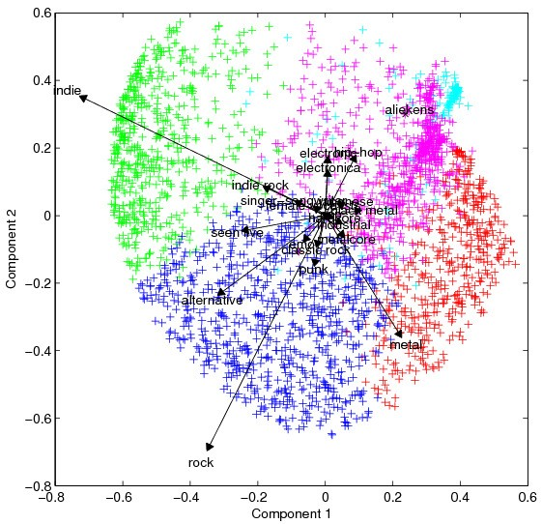
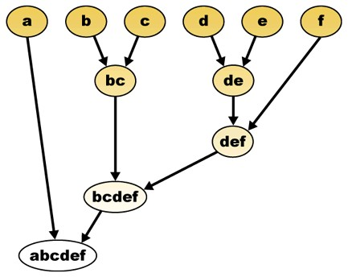
Two types of Clustering Algorithms
Hierarchical Clustering
Non- Hierarchical Clustering
Begin with n clusters; sequentially merge similar clusters until cluster is left.
Useful when goal is to arrange the clusters into a natural hierarchy.
Requires specifying distance measure.
Pre-specified number of clusters, assign records to each of the clusters.
Requires specifying # clusters
Computationally cheap

Slide 8
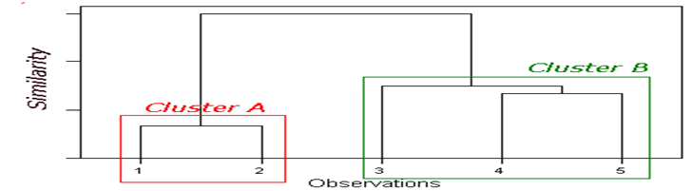
Hierarchical Clustering
Dendrogram: Tree-like diagram that summarize the clustering process.
Similar records joined by links.
Record location determined by similarity to other records.

Slide 9
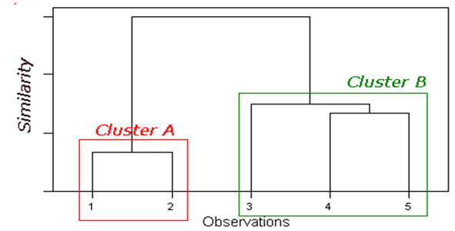
Hierarchical Clustering Algorithm
Start with n clusters (1 record in each cluster)
Step 1: two closest records are merged into one cluster
At every step, pair of records/clusters with smallest distance are merged.
– Two records are merged,
– Or single record added to an existing cluster,
– Or two existing clusters are combined.
Requires a definition of distance

Slide 10
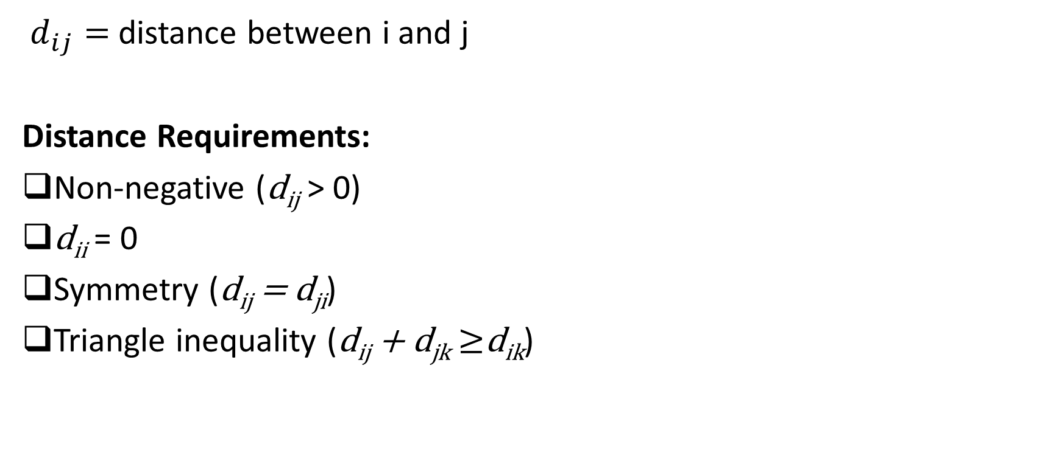
Pairwise distance between the records
$d_{ij}=$distance between i and j
Distance Requirements:
Non-negative (d_{ij} > 0)
d_{ii} = 0
Symmetry (d_{ij} = d_{ji})
Triangle inequality (d_{ij} + d_{jk} $≥$d_{ik})

Slide 11
Hierarchical Clustering Case Study- UG Business Programs
Data for 25 undergraduate programs at business schools in US universities in 1995.
This dataset excludes image variables (student satisfaction, employer satisfaction and deans’ opinions).

Slide 12
Distance between two universities
Notation:
x_{i} = (x_{i1,}x_{i2,…..,}x_{ip})
x_{j} = (x_{j1,}x_{j2,…..,}x_{jp})
Example:
Caltech= (1415, 100, 25, 6, 63575, 81)
Cornell = (1280, 83, 33, 13, 21864, 90)

Slide 13
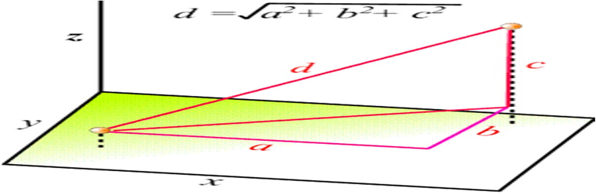
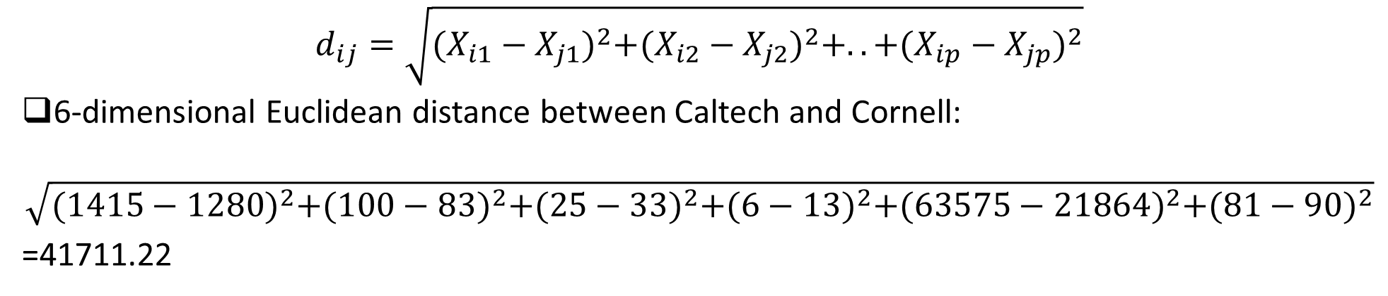
Euclidian Distance
$$d_{ij}=\sqrt{{(X_{i1}−X_{j1})}^{2}+{(X_{i2}−X_{j2})}^{2}+..+{(X_{ip}−X_{jp})}^{2}}$$
6-dimensional Euclidean distance between Caltech and Cornell:
$$\sqrt{{(1415−1280)}^{2}+{(100−83)}^{2}+{(25−33)}^{2}+{(6−13)}^{2}+{(63575−21864)}^{2}+{(81−90)}^{2}}$$
=41711.22

Slide 14
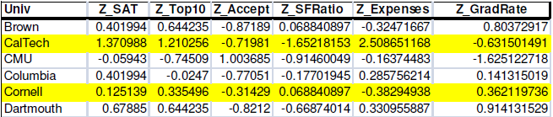
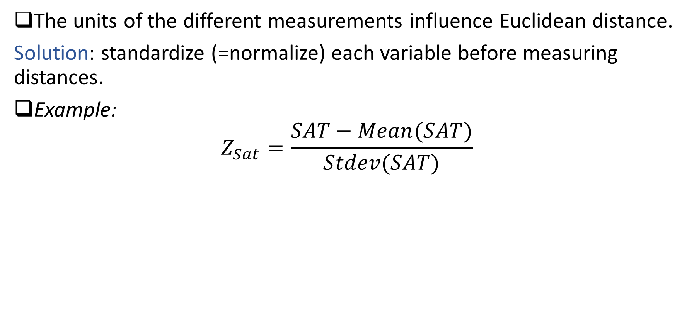
Standardize when there are multiple variables
The units of the different measurements influence Euclidean distance.
Solution: standardize (=normalize) each variable before measuring distances.
Example:
$$Z_{Sat}=\frac{SAT−Mean(SAT)}{Stdev(SAT)}$$

Slide 15
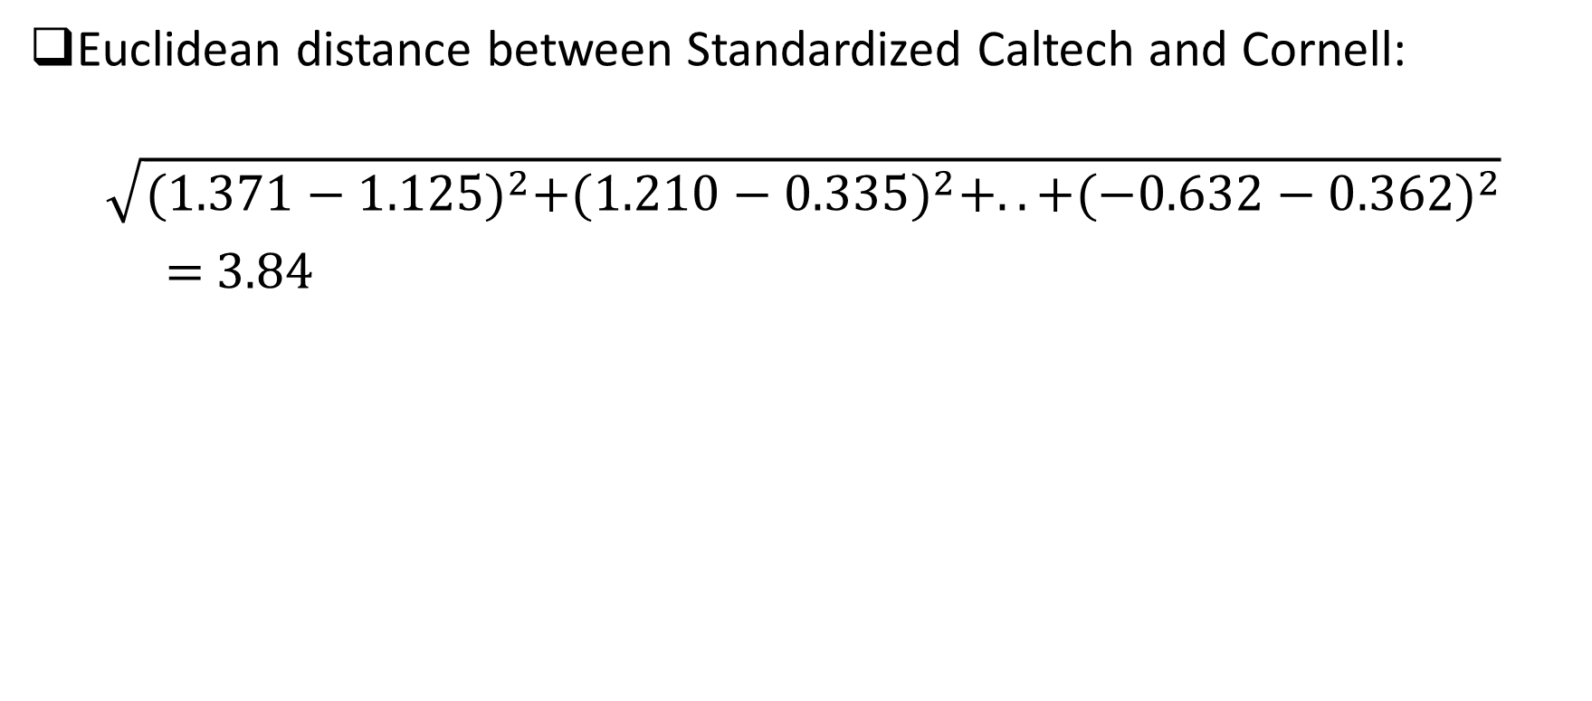
Standardize when there are multiple variables
Euclidean distance between Standardized Caltech and Cornell:
$$\sqrt{{(1.371−1.125)}^{2}+{(1.210−0.335)}^{2}+..+{(−0.632−0.362)}^{2}}$$
= 3.84

Slide 16
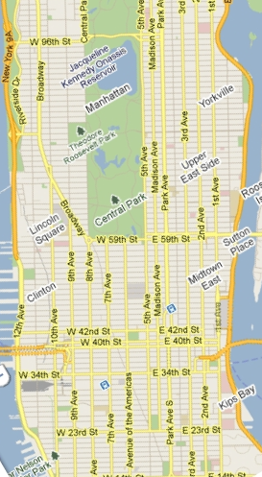
Other Distance Metrics
Statistical (Mahalanobis) distance:
Uses correlation matrix
Manhattan distance:
D_{ij =} | x_{i1}-x_{j1}|+| x_{i2}-x_{j2}|+…..+| x_{ip}-x_{jp}|
Matching-type metrics for categorical data (next slide)

Slide 17
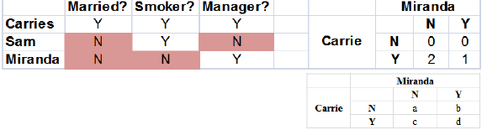
Distances for Binary Data
Similarity-based metrics based on 2x2 table of counts
Binary Euclidean Distance: (b+c)/ (a+b+c+d)
Simple Matching Coefficient: (a+d)/ (a+b+c+d)
Jacquard's coefficient: d/ (b+c+d)
For >2 categories, distance =0 only if both items have same category. Otherwise =1.

Slide 18
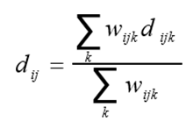
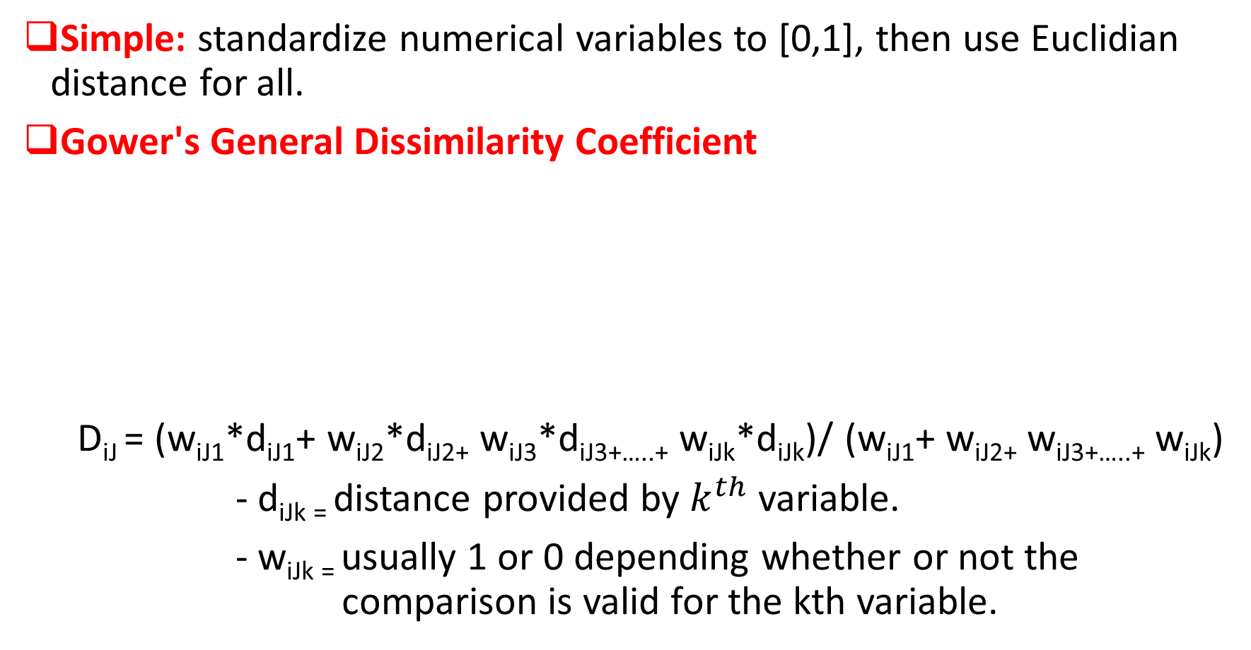
Distances for Mixed (Numerical + Categorical) Data
Simple: standardize numerical variables to [0,1], then use Euclidian distance for all.
Gower's General Dissimilarity Coefficient
D_{iJ} = (w_{iJ1}*d_{iJ1}+ w_{iJ2}*d_{iJ2+} w_{iJ3}*d_{iJ3+…..+} w_{iJk}*d_{iJk})/ (w_{iJ1}+ w_{iJ2+} w_{iJ3+…..+} w_{iJk})
- d_{iJk =} distance provided by $k^{th}$ variable.
- w_{iJk =} usually 1 or 0 depending whether or not the comparison is valid for the kth variable.

Slide 19
The Hierarchical Clustering Algorithm: Hands On
Start with n clusters (record= cluster)
Step 1: two closest records are merged into one cluster
At every step, pair of clusters with smallest distance are merged
-Two records are merged,
-or single record added to an existing cluster,
-or two existing clusters are combined.

Slide 20
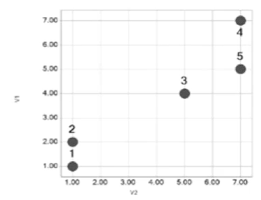
Hierarchical Clustering: Hands-on
Two variables, n=5 items:-
Item | V1 | V2
1 | 1 | 1
2 | 2 | 1
3 | 4 | 5
4 | 7 | 7
5 | 5 | 7
 | 1 | 2 | 3 | 4 | 5
1 | 0.0
2 | 1.0 | 0.0
3 | 5.0 | 4.5 | 0.0
4 | 8.5 | 7.8 | 3.6 | 0.0
5 | 7.2 | 6.7 | 2.2 | 2.0 | 0.0
Euclidian Distance Matrix

Slide 21
Hierarchical Clustering: Hands-on
Merge 1&2 into cluster A.
Use single linkage to compute distances from cluster A:
 | 1 | 2 | 3 | 4 | 5
1 | 0.0
2 | 1.0 | 0.0
3 | 5.0 | 4.5 | 0.0
4 | 8.5 | 7.8 | 3.6 | 0.0
5 | 7.2 | 6.7 | 2.2 | 2.0 | 0.0
 | 1 | 2 | 3 | 4 | 5
1 | 0.0
2 | 1.0 | 0.0
3 | 5.0 | 4.5 | 0.0
4 | 8.5 | 7.8 | 3.6 | 0.0
5 | 7.2 | 6.7 | 2.2 | 2.0 | 0.0

Slide 22
Hierarchical Clustering: Hands-on
What Happens Next?
Merge 4 & 5 (cluster B)
Merge 3 & B
 | A | 3 | B
A | 0.0
3 | 4.5 | 0.0
B | 6.7 | 2.2 | 0.0
 | A | B
A | 0.0
B | 4.5 | 0.0

Slide 23
Hierarchical Clustering: Hands-on
Finally: Summarize process in a Dendrogram

Slide 24
Why cluster universities?
How can clustering help a prospective applicant?
How can clustering help a business school dean?
Evaluating usefulness of clustering
What characterizes each cluster?
Can you give a “name” to each cluster?
Does this give us any insight?
Insights? Anything Interesting?

Slide 25
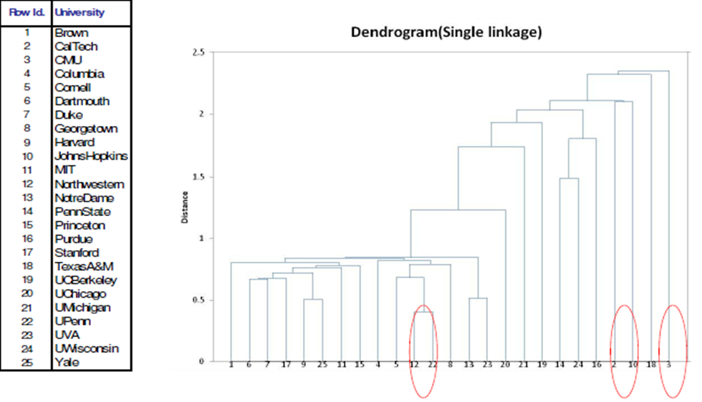
Insights? Anything Interesting?

Slide 26
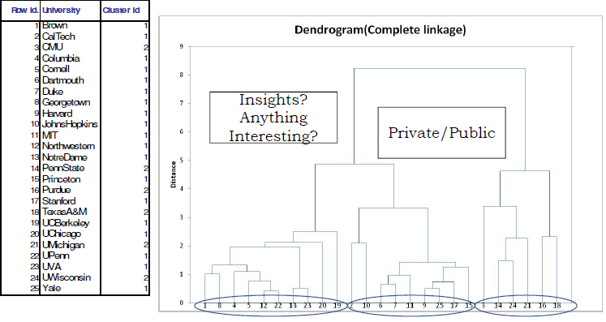
Dendrogram for Business School Example with Complete Linkage

Slide 27
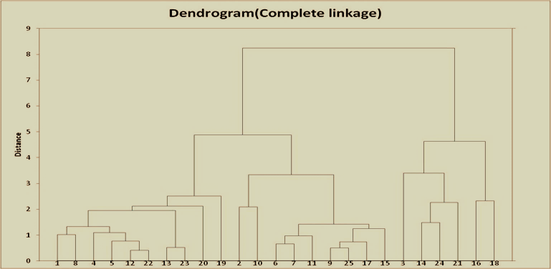
From Dendrograms to Clusters
After dendrogram is obtained, cut it to create clusters. How?
Examine distance levels
Cut point determines # clusters
Obtain statistics on resulting clusters

Slide 28
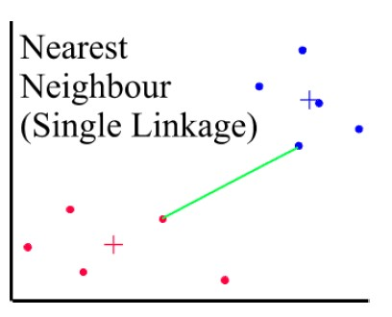
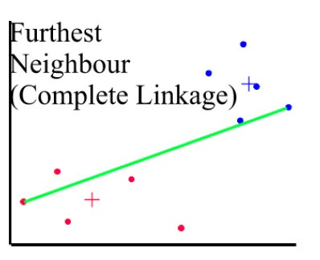
Distances Between Clusters: Single Linkage(Nearest Neighbor)
Distances Between Clusters: Complete Linkage (Farthest Neighbor)
Distance between 2 clusters = minimum distance between members of the two clusters
Distance between 2 clusters = greatest distance between members of the two clusters.

Slide 29
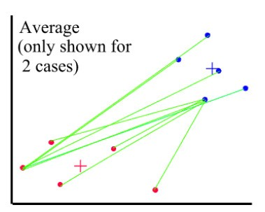
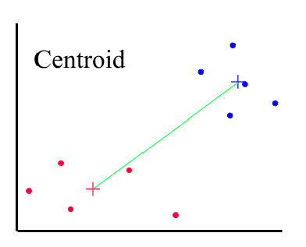
Distances Between Clusters: Average Linkage
Distances Between Clusters: Centroid Linkage
Distance between 2 clusters = average of all distances between members of the two clusters.
Distance between 2 clusters = distance between their centroids (Centers).

Slide 30
Pairwise distance between clusters
Single linkage (nearest neighbor): minimum distance between members of the two clusters.
Complete linkage (farthest neighbor): greatest distance between members of the two clusters
Average linkage: average of all distances between members of the two clusters.
Centroid linkage: distance between their centroids (centers)

Slide 31
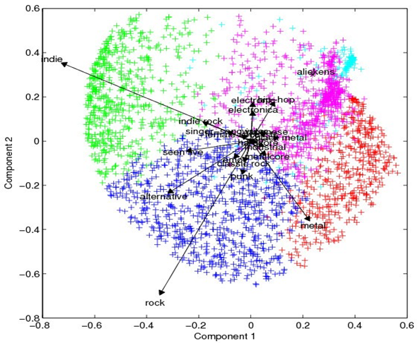
K-means Clustering
Predetermined number (K) of non-overlapping clusters
Clusters are homogeneous yet dissimilar to other clusters
Need measures of within-cluster similarity (homogeneity) and between-cluster similarity
No hierarchy (no dendrogram).
End Product is final cluster memberships.
Useful for large data sets.

Slide 32
K-means Clustering- Algorithm minimizes within-cluster variance (heterogeneity)
1. For a user-specified value of K, partition dataset into K initial clusters (next slide).
2. For each record, assign it to cluster with closest centroid.
3. Re-calculate centroids for the “losing” and “receiving” clusters. can be done.
• After reassignment of each record, or
• After one complete pass through all records (cheaper)
4. Repeat Steps 2-3 until no more reassignment is necessary.

Slide 33
Initial partition into K clusters
Initial partitions can be obtained by either
1. User-specified initial partitions, or
2. User-specified initial centroids, or
3. Random partitions
Stability: Run algorithm with different initial partitions

Slide 34
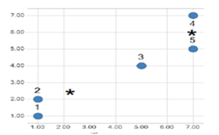
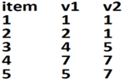
K-means Clustering: Hands on
Example k=2
Start with cluster A:1,2,3 and with cluster B: 4,5
Compute cluster centroids.

Slide 35
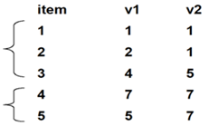
K-means Clustering: Hands on
What are centroids of cluster A & B?
A=(1,1.5,4.5) and B=(7,6)
A=(2.33) and B=(6.5)
A=(2.33,2.33) and B=(6,7)

Slide 36
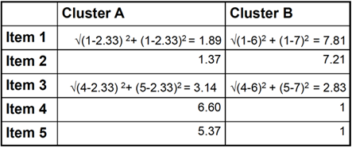
K-means Clustering: Hands on
Compute Euclidean distance of each record of from each centroid, and re-assign to closest cluster.

Slide 37
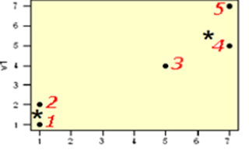
K-means Clustering: Hands on
First iteration results:
Cluster A:1,2 and Cluster B: 3,4,5
Re-Compute centroids:
Centroid(A) = (1.5,1) Centroid(B) = (5.33,6.33)

Slide 38
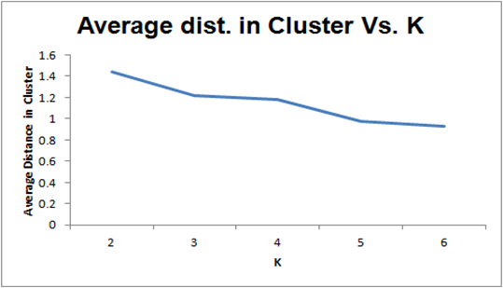
Selecting K
Re-run algorithm for different values of K
• Tradeoff: simplicity (interpretation) vs. adequacy (within-cluster homogeneity)
• Plot within-cluster variability as a function of K
Choice is subjective.

Slide 39
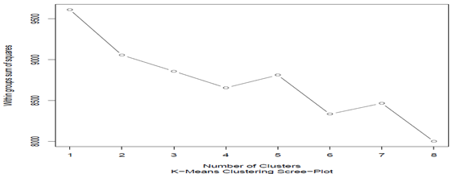
K-Means Clustering Scree Plot
Scree-plot or elbow plot shows that there is a clear bend at 2 clusters, hence we are considering that there are 2 clusters (categories) that the data can be segregated into
Note: Analysis is done considering slight bend at 2nd cluster and considering steep bend at 4th cluster, however, it did not provide any meaningful insights

Slide 40
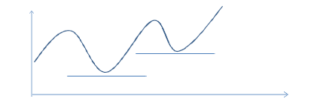
Why multiple start points (initial partitions) may be necessary?
Why multiple start points (initial partitions) may be necessary?
• K-means clustering is a minimization problem
• Existence of multiple local minima

Slide 41
Convergence/robustness of K-means
Procedure might oscillate indefinitely
• Convergence criterion:
– Stop when a cluster centroid moves less than a % of smallest distance between any of the centroids
– Specify the maximum number of iterations

Slide 42
Final checks
Cluster stability: do cluster assignments change dramatically if some inputs are slightly altered?
Cluster separation: compare between-cluster variation to within cluster variation.

Slide 43
K-Means vs. Hierarchical: K-Means
The Good
The Bad
Computationally fast for large datasets
Useful when certain K needed
Can take long to terminate
Final solution not guaranteed to be “globally optimal”
Different initial partitions can lead to different solutions
Must re-run the algorithm for different values of K
No dendrogram

Slide 44
K-Means vs. Hierarchical: Hierarchical
The Good
The Bad
Require computation & storage of n x n distance matrix
Algorithm makes only one pass through the data. Records that are incorrectly allocated early on cannot be reallocated subsequently
Low stability: Reordering data or dropping a few records can lead to different solution
Single complete linkage robust to distance metric if the relative ordering is kept. Average linkage is NOT.
Most distances sensitive to outliers.
Finds “natural” grouping – no need to specify number of clusters
Dendrogram: transparency of process, good for presentation

Slide 45
NEXT TOPIC> TEXT MINING

